Slide 1
SESSION 7
Timer

Slide 2
Timer
1- interrupt with time
2- output on ocn with time
3- using a counter for the tn

Slide 3
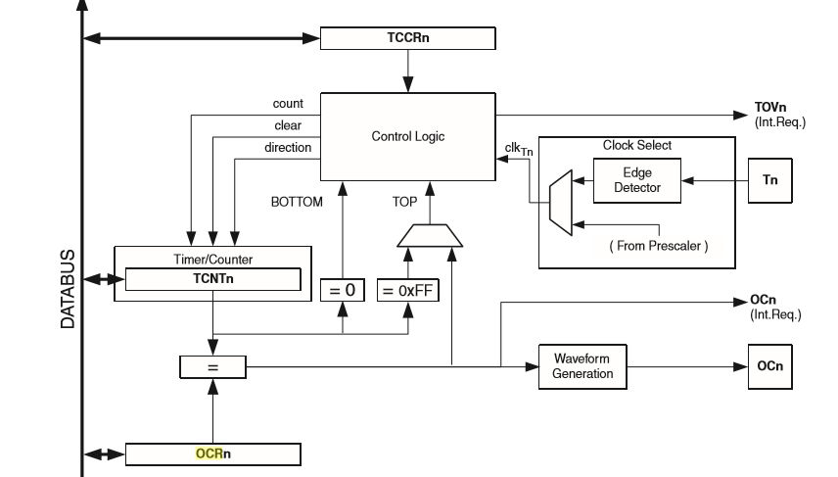
Determine the mode
The counter
Output compare

Slide 4
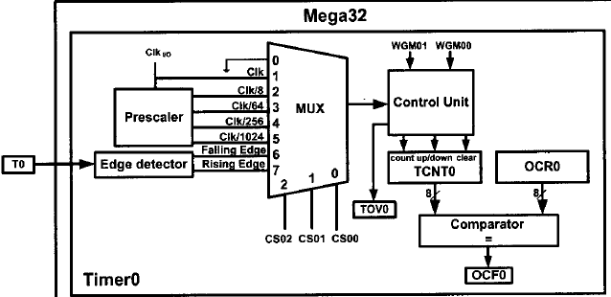

Slide 5





Slide 6

Modes of operation
1- Normal mode
2-clear time on compare match
( CTC mode)
3-Fast PWM mode
4-Phase PWM mode

Slide 7
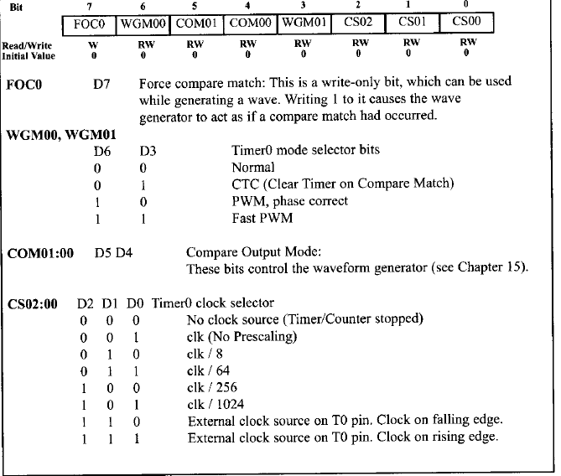

Slide 8
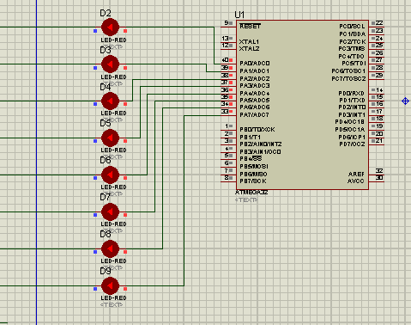
NORMAL

Slide 9
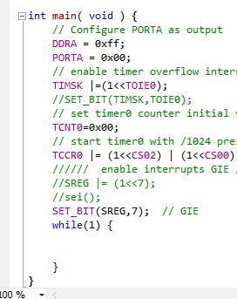
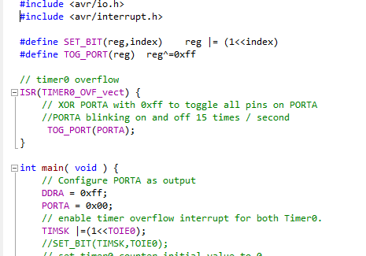

Slide 10


Slide 11
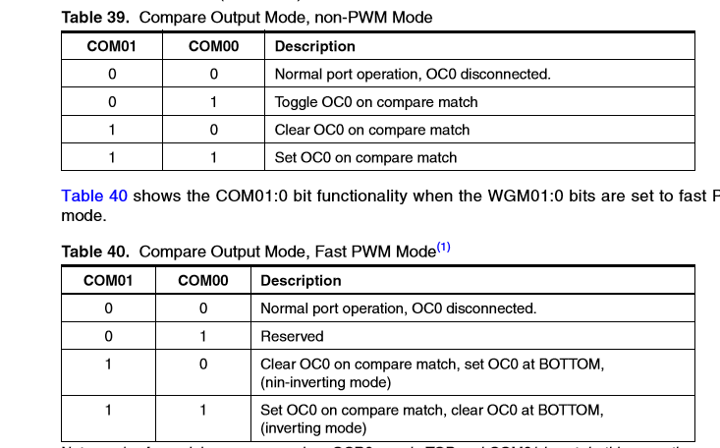

Slide 12
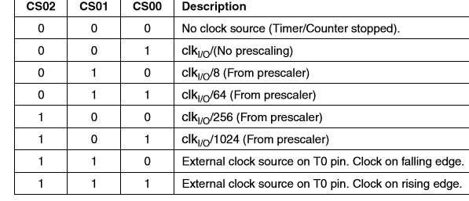

Slide 14



Slide 15
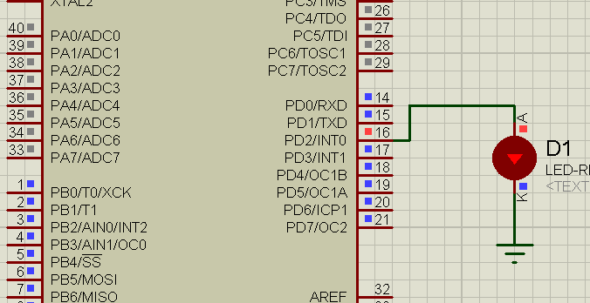
CTC mode

Slide 16
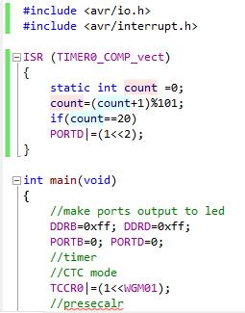
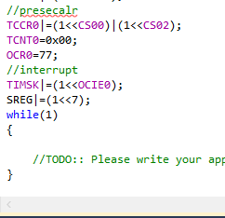

Slide 17
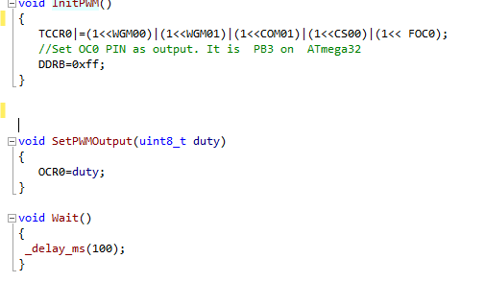
PWM

Slide 18
